Slide 1
Applied Machine learning
Regent College London
SWE6302

Slide 2
Applied Machine learning
SWE6302

Slide 3

Applied Machine learning
NAÏVE BAYES TECHNIQUE
& SVM

Slide 4
Learning objectives
Confusion Matrix
Making a classification syntax
Understand the Bayes theorem
Understand the how Naïve Bayes algorithm work
Application of Naïve Bayes
K-Folds and Cross validation
Understand Support Vector Machines
Examples using Python

Slide 5
Module 1 – Confusion Matrix

Slide 6
Confusion matrix
A confusion matrix is a, table layout that summarizes the performance of a classification model by comparing predicted labels against true labels. It provides a detailed, class-wise breakdown of correct predictions and types of errors (false positives/negatives), offering deeper insight than accuracy alone

Slide 7
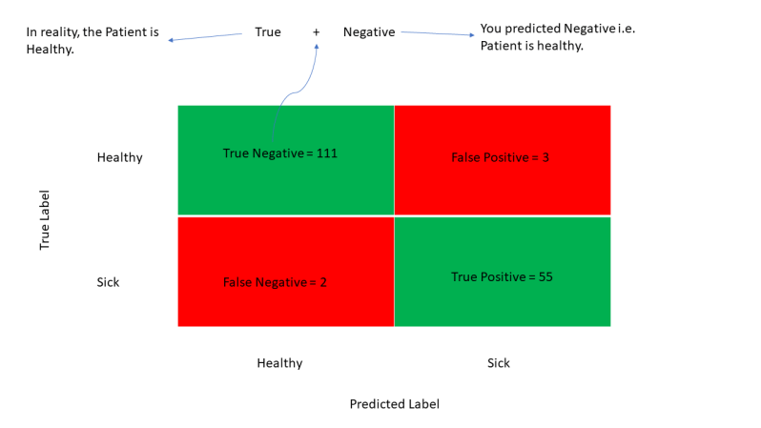
Confusion matrix
TP-True Positive cases when the classifier predicted TRUE (they have the disease) and the correct class was TRUE (patient has the disease)
TN-True Negative cases when the classifier predicted FALSE (no disease) and the correct class was FALSE (patient do not have the disease)
FP-False Positive cases when the classifier predicted TRUE , but the correct class was FALSE (Patient did not have the disease) –Type I Error
FN-False Negative classifier predicted FALSE (patient do not have disease) but they actually do have the disease-Type II Error
(BPRASAD.2022)
Notes:
Simple explanation :
Machine Learning Basics: Confusion Matrix & Precision/Recall Simplified | By Dr. Ry @Stemplicity
Professor Ryan
True Positives (TP) – True Positives occur when we predict an observation belongs to a certain class and the observation actually belongs to that class.
True Negatives (TN) – True Negatives occur when we predict an observation does not belong to a certain class and the observation actually does not belong to that class.
False Positives (FP) – False Positives occur when we predict an observation belongs to a certain class but the observation actually does not belong to that class. This type of error is called Type I error.
False Negatives (FN) – False Negatives occur when we predict an observation does not belong to a certain class but the observation actually belongs to that class. This is a very serious error and it is called Type II error.

Slide 8
Example of confusion matrix
Let us calculate the TP, TN, FP, and FN values for the class Setosa using the Above tricks:
TP: The actual value and predicted value should be the same. So, concerning Setosa class, the value of cell 1 is the TP value.
FN: The sum of values of corresponding rows except for the TP value
FN = (cell 2 + cell3) == (0 + 0)= 0
FP: The sum of values of the corresponding column except for the TP value.
FP = (cell 4 + cell 7)= (0 + 0)= 0
TN: The sum of values of all columns and rows except the values of that class that we are calculating the values for.
TN = (cell 5 + cell 6 + cell 8 + cell 9)= 17 + 1 +0 + 11= 29
Predicted Values
Actual Values |  | Setosa | Versicolor | Virginica
 | Setosa | 16 C1 | 0 C2 | 0 C3
 | Versicolor | 0 C4 | 17 C5 | 1 C6
 | Virginica | 0 C7 | 0 C8 | 11 C9

Slide 9
Module 2 – Naïve Bayes Classifier

Slide 10
Naïve Bayes Classifier
It is a statistical classification technique based on Bayes Theorem
Supervised learning algorithm
It has high accuracy and speed on larger datasets
NBC assumes that effect of particular feature in a class is independent of other features.
For example, if a loan is applicable or not depends on income, previous loan, age etc. Even if these features are interdependent , these features are still considered independent.
This assumption simplifies computation and so it is considered as naïve and the assumption is called class conditional independence

Slide 11
Cont..
That is changing the value of one feature, does not directly influence or change the value of any of the other features used in the algorithm.
It really is a naive assumption to make about real-world data.
For example, if you use Naive Bayes for sentiment analysis, given the sentence ‘I like Harry Potter’, the algorithm will look at the individual words and not the full sentence. In a sentence, words that stand next to each other influence the meaning of each other, and the position of words in a sentence is also important. However, for the algorithm, phrases like ‘I like Harry Potter’, Harry Potter like I’, and ‘Potter I like Harry’ are the same.

Slide 12
Advantages & Disadvantage of naïve bayes
Turns out that the algorithm is able to effectively solve many complex problems. For example, building a text classifier with Naive Bayes is much easier than with more hyped algorithms such as neural networks.
The model works well even with insufficient or mislabeled data, so you don’t have to ‘feed’ it hundreds of thousands of examples before you can get something reasonable out of it.
Even if Naive Bayes can take as much as 50 lines, it is very effective.
It performs better with categorical than with numerical values.
It automatically assumes the bell curve distribution, which is not always right.

Slide 13
Where is naïve bayes used
Document classification. This algorithm can help you to determine to which category a given document belongs. It can be used to classify texts into different languages, genres, or topics (through the presence of keywords).
Spam filtering. Naive Bayes easily sorts out spam using keywords. For example, in spam, you can see the word ‘hmrc-tax-refund’ much more often than in regular mail. The algorithm must be trained to recognize such probabilities and, then, it can efficiently apply them for spam filtering.
Sentiment analysis. Based on what emotions the words in a text express, Naive Bayes can calculate the probability of it being positive or negative. For example, in customer reviews, ‘good’ or ‘inexpensive’ usually mean that the customer is satisfied. However, Naive Bayes is not sensitive to sarcasm.
Image classification. For personal and research purposes, it is easy to build a Naive Bayesian classifier. It can be trained to recognize hand-written digits or put images into categories through supervised machine learning.

Slide 14
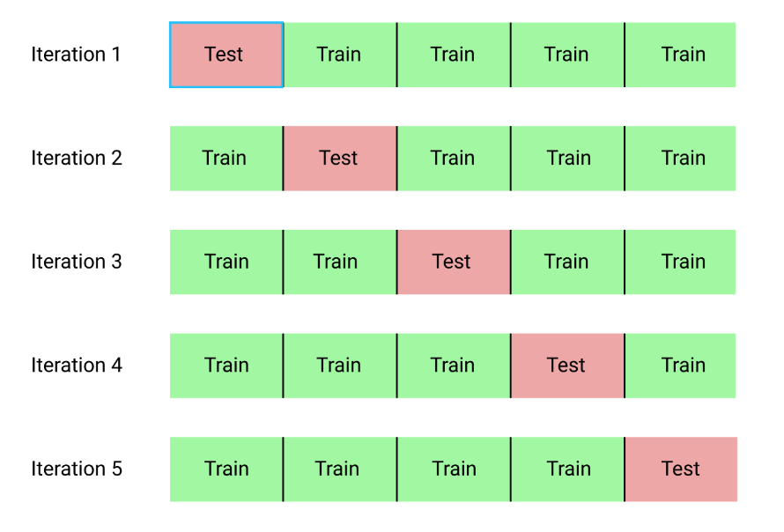
K-fold Cross Validation
In train-test split you're a setting aside a chunk of your data, so you won't be able to use it to train your algorithm.
Also data is sampled at random, it has a chance of being skewed in some way, not representing the whole dataset properly.
K-fold cross validation addresses these problems.
First split the data into several (10 for example, if k = 10) subsets, called folds.
Then you train and evaluate your model 10 times, setting aside each one of the folds in turn, and training the model on the remaining 9 folds
K-fold cross-validation can be used to select the best model among a set of candidate models.

Slide 15
Using python
Example Using Naïve Bayes Classifier by K-Fold and validating by Cross_val_score()
See the Practical Implementation

Slide 16
Introduction to probability
Weather conditions and playing sports. You need to calculate the probability of playing sports. So, to classify whether players will play or not.
Prior and posterior probability calculation, can use the frequency and the likelihood tables.
Frequency table contains the occurrence of labels for all features
These are likelihood tables.
Notes:
Naive Bayes Classifier Tutorial: with Python Scikit-learn | DataCamp

Slide 17

Bayes theorem
Bayes' Theorem is a mathematical formula used to determine the conditional probability of an event, based on prior knowledge of conditions that might be related to the event. It allows for the updating of probability estimates as new evidence is presented.
Where:
𝑃(𝐴∣𝐵) is the probability of event A occurring given that B is true.
𝑃(𝐵∣𝐴) is the probability of event B occurring given that A is true.
𝑃(𝐴) and 𝑃(𝐵) are the probabilities of events A and B independently of each other.
https://www.youtube.com/watch?v=vz_xuxYS2PM

Slide 18
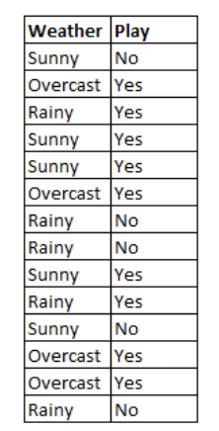
How naïve Bayes algorithm works?
Let’s understand it using an example. Below I have a training data set of weather and corresponding target variable ‘Play’ (suggesting possibilities of playing). Now, we need to classify whether players will play or not based on weather condition. Let’s follow the below steps to perform it.
Step 1 - Convert the data set into a frequency table
Step 2 - Create Likelihood table by finding the probabilities

Slide 19
Frequency table
 | Frequnecy Table
Weather | No | Yes
Overcast
Rainy
Sunny
Total

Slide 20
Likelihood table
 | Likelyhood Table
Weather | No | Yes
Overcast |  | 4 | 0.29
Rainy | 3 | 2 | 0.36
Sunny | 2 | 3 | 0.36
Total | 5 | 9
 | 0.36 | 0.64

Slide 21
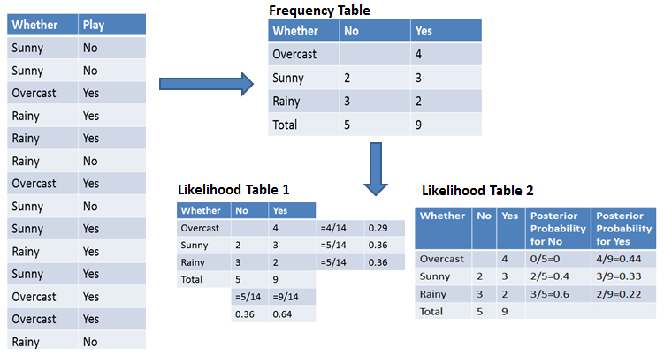
Naïve bayes technique

Slide 22
Probabilty
P(Yes|Overcast) ?
Probability of playing:
P(Yes | Overcast) = P(Overcast | Yes) P(Yes) / P (Overcast) .....................(1)
Calculate Prior Probabilities:
P(Overcast) = 4/14 = 0.29
P(Yes)= 9/14 = 0.64
Calculate Posterior Probabilities:
P(Overcast |Yes) = 4/9 = 0.44
Put Prior and Posterior probabilities in equation (1)
P (Yes | Overcast) = 0.44 * 0.64 / 0.29 = 0.98(Higher)
Notes:
Probability of playing:
P(Yes | Overcast) = P(Overcast | Yes) P(Yes) / P (Overcast) .....................(1)
Calculate Prior Probabilities:
P(Overcast) = 4/14 = 0.29
P(Yes)= 9/14 = 0.64
Calculate Posterior Probabilities:
P(Overcast |Yes) = 4/9 = 0.44
Put Prior and Posterior probabilities in equation (1)
P (Yes | Overcast) = 0.44 * 0.64 / 0.29 = 0.98(Higher)

Slide 23
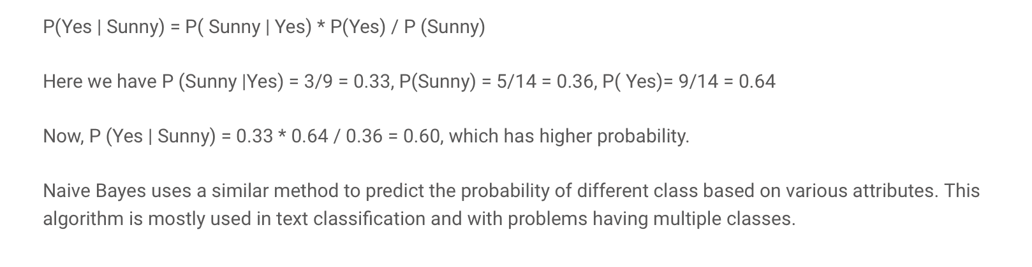
example

Slide 24
Module 3 – Support vector machine

Slide 25
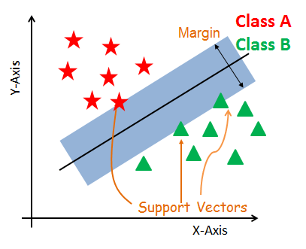
SVM introduction
Support vector machine is mostly considered as a Classification Algorithm but can be used for Regression as well.
SVM constructs a hyperplane in multidimensional space to separate different classes.
SVM generates optimal hyperplane in an iterative manner, which is used to minimize an error.
The core idea of SVM is to find a maximum marginal hyperplane(MMH) that best divides the dataset into classes.
Notes:
https://www.datacamp.com/tutorial/svm-classification-scikit-learn-python

Slide 26
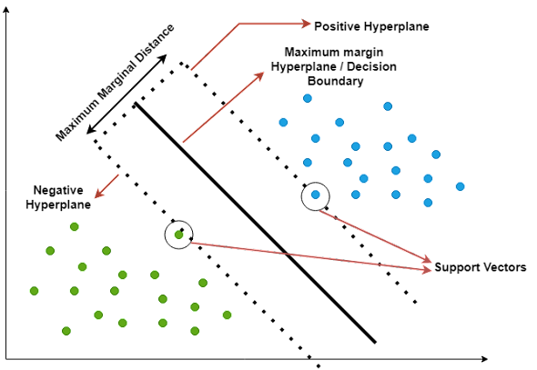
Key terms
Decision Boundary: a line or surface that separates different regions in a data space. Each region is associated with a class label, and the decision boundary is used to predict the class label of new data points.
Decision boundary can be a line or plane that separates the data space into two regions, one associated with the class label +1 and the other with the class label -1.
When the decision boundary is more than 2-dimensional, it is called a hyperplane.
Support Vectors: data points that lie closest to the separating line between the two classes.
Marginal Distance: is the distance between the closest point in the training data set and the decision boundary. Increasing the margin distance can lead to improved generalization performance, ie, better out-of-sample prediction.
Linear Separability: split into two groups using a single line.
Non-linear separability: Non-linear separable data is data that cannot be separated by a linear line.
(Siddarth,2022)
Notes:
Pycomates
(Siddarth,2022)

Slide 27
SVM Working
A hyperplane between the two classes of data, and then finding the best line that separates them. The best line that separates the data is the one that has the most distance from all the data points in one class and the least distance from all the data points in the other class.
To find this line:
SVM uses a technique called “linear regression”. Linear regression finds the best line that fits a set of data points.
to find the line that has the smallest “error”. Error is just a fancy word for the distance between a data point and the line.
SVM uses a technique called “support vectors”: Support vectors are data points that lie on the hyperplane. They are the most important data points because they help to define the hyperplane that can separate the data points.
The decision boundary or decision hyperplane including all the support vectors is the one that maximizes the margin between the two classes.
Notes:
pycomates

Slide 28
SVM Working cont..
Aim of SVM is to increase the marginal distance(as shown in the graph) as much as possible so as to reduce the generalization error.
Increasing the marginal distance will improve the performance of the model on unseen data.
So here what happens is that when the margin distance increases the possibility of predicting the wrong class will decrease since the decision boundary is now far from the points of the two separate classes.
So when considering a new data point, if it lies near to negative hyperplane(shown on the graph) it is more likely to belong to the negative class and if it lies near the positive hyperplane it is more likely to belong to the positive class.
When training the SVM model, we first need to find the support vectors.
Then we need to find the line that maximizes the margin between the two classes.
This line is the decision boundary.
Once we have the decision boundary, we can use it to predict the class of new data points.
Notes:
pycomates

Slide 29
Advantages and disadvantages
SVM Classifiers offer good accuracy
Perform faster prediction compared to Naïve Bayes algorithm.
Uses less memory because they use a subset of training points in the decision phase.
SVM works well with a clear margin of separation and with high dimensional space.
Not suitable for large datasets because of its high training time and it also takes more time in training compared to Naïve Bayes.
It works poorly with overlapping classes
Sensitive to the type of kernel used.
Notes:
https://www.datacamp.com/tutorial/svm-classification-scikit-learn-python

Slide 30
Tuning hyperparameters
Kernel:
Regularization
Gamma
Kernel: To transform the dataset into the required form
Functions: Linear, Polynomial and RBF- Radial basis function

Slide 31
Tuning hyperparameters
Kernel:
Regularization
Gamma
Regularization: To maintain regularization, C is the penalty parameter.
C represents mis-classification or error term
A small value of C creates Small-margin hyperplane
Larger value of C creates a larger-margin hyperplane

Slide 32
Tuning hyperparameters
Gamma: Small value loosely fit the training set
Large value exactly fit the training set resulting in overfitting
Low value of Gamma consider nearby points for separation of the line.
High value of Gamma considers all data points for separation of the line.
Kernel:
Regularization
Gamma

Slide 33
parameters
C is typically used as a regularization parameter to control overfitting, allowing the algorithm to make more accurate predictions on new data points. The strength of the regularization is inversely proportional to C. C represents the penalty parameter for misclassifying data points.
Simply speaking, C controls the trade-off between maximizing the margin and minimizing training error. If C is set too low, the model will fail to accurately classify data points due to underfitting and can produce inaccurate results. A smaller value of C will result in a larger margin, but may lead to more misclassifications. If C is set too high, then the model will have difficulty correctly separating data points due to overfitting and can show poor accuracy scores. A larger value of C will result in a smaller margin, but may lead to better classification accuracy.
The choice of C depends on the problem at hand and the characteristics of the dataset. In general, a smaller value of C is preferred when the dataset is noisy, or when the goal is to have a more generalizable model that can perform well on new, unseen data. A larger value of C is preferred when the dataset is clean and the goal is to maximize classification accuracy on the training data.
As a general guideline, it’s a good idea to start with a smaller value of C and gradually increase it until the desired level of classification accuracy is achieved. However, it’s important to keep in mind that a larger value of C may lead to overfitting, which means that the model performs well on the training data but poorly on new, unseen data. Therefore, it’s important to strike a balance between maximizing the margin and minimizing the classification error, and choose an appropriate value of C based on the specific problem and dataset.

Slide 34
parameters
When training a support vector machine (SVM) model using Sklearn SVC algorithm, the gamma hyperparameter can take on two special values: ‘scale’, ‘auto’ or ‘float’. When gamma is set to ‘scale’, it means that the value of gamma is calculated as 1 / (number of features * variance in data). This ensures that all features are given equal importance in the model and produces consistent results no matter how many features are used.
SVM kernel is a mathematical function that is used to map the data points from one space into another, usually higher dimensional space. When training a support vector machine (SVM) model using Sklearn SVC algorithm, the kernel hyperparameter can take on several values: ‘linear’, ‘poly’, ‘rbf’ and ‘sigmoid’.
  When kernel is set to ‘linear’, it means that the model will use a linear boundary for classification and regression. This is the simplest type of SVM and works best when data are linearly separable.
  When kernel is set to ‘poly’, it means that the model will use polynomial functions of degree higher than 1 for classification. This type of SVM is more suitable for complex non-linear datasets.
  When kernel is set to ‘rbf’, it means that the model will use radial basis funcitons for classification or regression. RBF kernels are capable of dealing with complex multi-class datasets and have good generalization performance with noisy data points.

Slide 35
Application of svm
Sentiment analysis: A support vector machine can be used to classify the sentiment of a text as positive, negative, or neutral.
Spam detection: Can be used to classify emails as spam or not spam.
Image recognition: Can be used to identify objects in images.
Fraud detection: Can be used to identify fraudulent activity.
Stock prediction: Can be used to predict future stock prices.
Weather prediction: Can be used to predict future weather patterns.
Disease diagnosis: Can be used to diagnose diseases like cancer.
Notes:
https://www.pycodemates.com/2022/07/support-vector-machines-detailed-overview.html

Slide 36
Overview: svm
Works well for classifying higher-dimensional data (lots of features)
Finds higher-dimensional support vectors across which to divide the data (mathematically, these support vectors define hyperplanes. Needless to say I’m not going to get into the mathematical details!)
Uses something called the kernel trick to represent data in higher- dimensional spaces to find hyperplanes that might not be apparent in lower dimensions

Slide 37
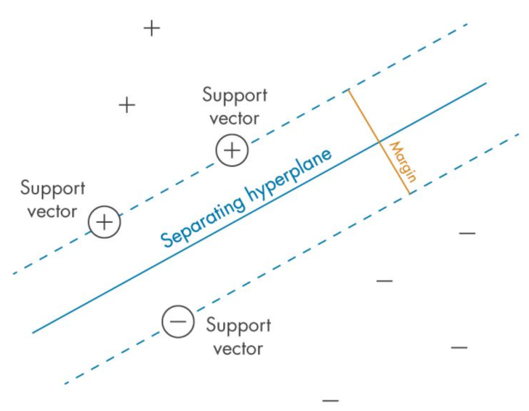
SVM
Support Vector Machines (SVMs) are a powerful and versatile machine learning algorithm that has gained widespread popularity among data scientists in recent years.
SVMs are widely used for classification, regression, and outlier detection (one-class SVM), and have proven to be highly effective in solving complex problems in various fields, including computer vision (image classification, object detection, etc.), natural language processing (sentiment analysis, text classification, etc.), and bioinformatics (gene expression analysis, protein classification, disease diagnosis, etc.).
At times, SVM for classification is termed as support vector classification (SVC) and SVM for regression is termed as support vector regression (SVR).

Slide 38
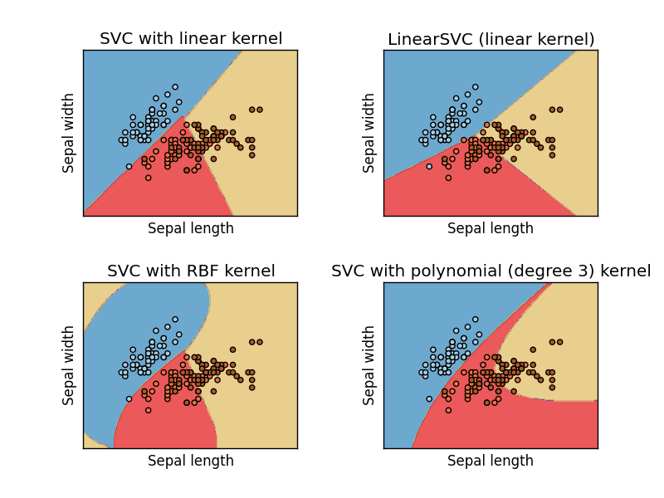
Support vector classification (SVC)
In practice you’ll use something called SVC to classify data using SVM.
You can use different “kernels” with SVC. Some will work better than others for a given data set.

Slide 39
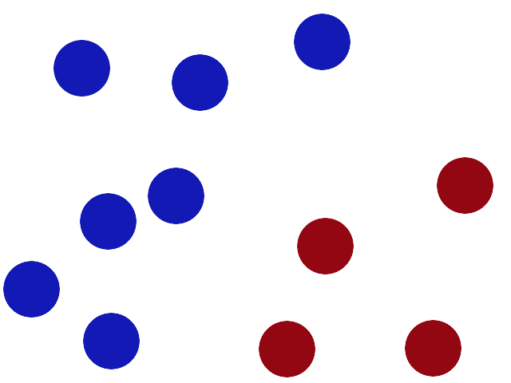
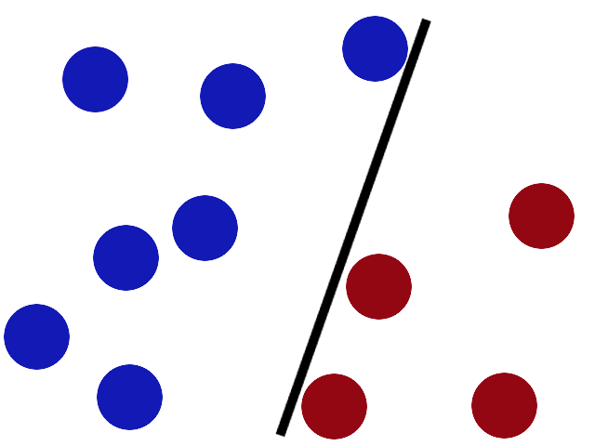
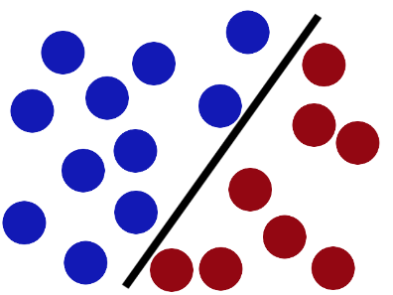
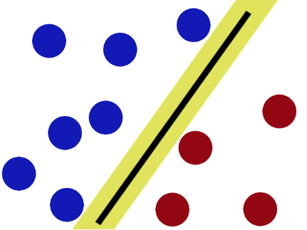
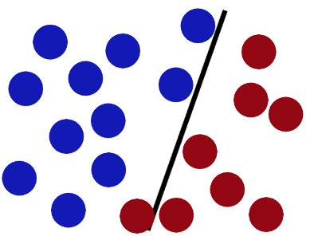
How svm works
Support vector machines (SVM); this classifier works well in complicated feature domains, albeit requiring clear separation between classes.
SVMs don't work well with noisy data
http://i.imgur.com/zDBbD.png
http://i.imgur.com/aLZlG.png
SVMs try to put the stick in the best possible place by having as big a gap on either side of the stick as possible.
http://i.imgur.com/BWYYZ.png
http://i.imgur.com/kxWgh.png
http://i.imgur.com/ePy4V.png
Notes:
JEREMY JORDAN

Slide 40
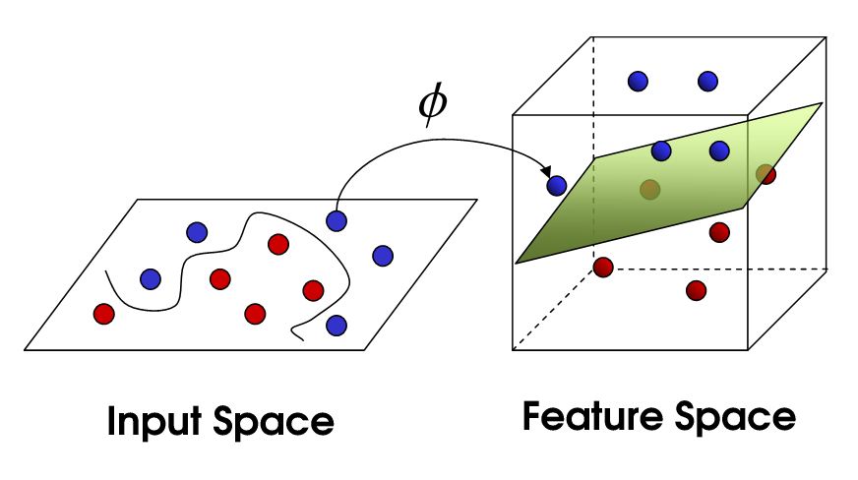
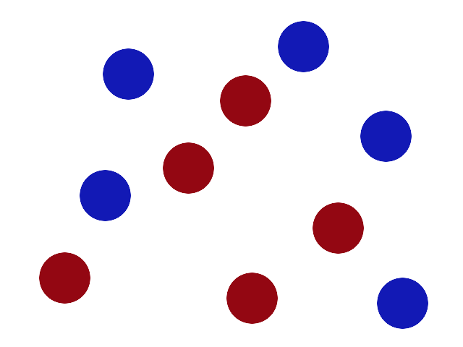
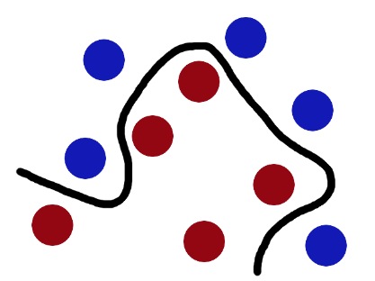
Another challenge
Non-linear SVM:
http://i.imgur.com/WuxyO.png
Balls data, the stick is a classifier, the biggest gap trick is called optimization, flipping the table is called kernelling and the piece of paper a hyperplane.
http://i.imgur.com/gWdPX.png

Slide 41
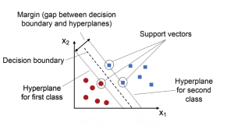
Visual view
Kumar.A. 2023.Support Vector Machine (SVM) Python Example.https://vitalflux.com/classification-model-svm-classifier-python-example/
Kumar.A. 2023
Notes:
The main idea behind SVM classifier is to find a hyperplane that maximally separates the data points of different classes. In other words, we are looking for the largest margin between the data points belonging to two classes. The hyperplane is selected such that it maximizes the distance between the hyperplane and the closest data points from each class, which are called support vectors. These points have a direct impact on the position and orientation of the hyperplane. The rationale behind having decision boundaries with large margins is that they tend to have a lower generalization error, whereas models with small margins are more prone to overfitting. Hence, SVM classifier is also termed as maximum margin classifier, meaning that it finds the line or hyperplane that has the largest distance to the nearest training data points (support vectors) of any class. The following picture represents the same.

Slide 42
example
Given labeled training data (for supervised learning), the SVM classification algorithm outputs an optimal hyperplane which categorizes new data examples into different classes.
This hyperplane is then used to make predictions on new data points. Let’s take an example to understand Support Vector Machine concepts in a better manner. Say you have been asked to predict whether a customer will churn or not and you have all their past transaction records as well as demographic information.
After exploring the data, you’ve found that there’s not much difference between the average transaction amount of customers who churned and those who didn’t. You also found that most of the customers who churned live relatively far from the city center.
Based on these findings, you decided to use Support Vector Machine classification algorithm to build your prediction model. Model trained using SVM classification algorithm will be able to classify the customers as high risk (churned) or otherwise.
There are some key concepts that are important to understand when working with SVMs. First, the data points that are closest to the hyperplane are called support vectors. Second, when the data is not linearly separable, SVMs use a technique called kernel trick, which maps the original features into a higher-dimensional feature space where the data is linearly separable.
In this new feature space, we can draw a hyperplane that separates the two classes. three hyperparameters that results in different SVM models (hypothesis): C, gamma and kernel function.

Slide 43
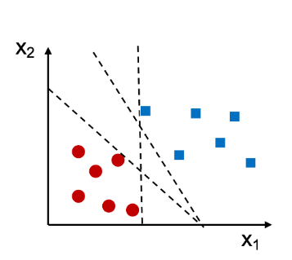
example
As an example, let’s say we have a dataset with two features (x1 and x2) and two classes (0 and 1). We can visualize this data by plotting it in a two-dimensional space, with each point colored according to its class label. Look at the diagram below.
In the above case, we can see that there are different straight lines that can perfectly separate the two classes.
However, we can still find a decision boundary that does a pretty good job.
This boundary is generated by Support Vector Machine algorithm. Using SVM algorithm, as mentioned above, training the model represents finding the hyperplane (dashed line in the picture below) which separates the data belonging to two different classes by maximum or largest margin. And, the points closest to this hyperplane are called support vectors.

Slide 44

visual
The blue square points represent one class and the red dots represent another class. The black line is the decision boundary learned by an SVM.
As you can see, the SVM has placed the boundary in such a way as to maximize the margin between the two classes. Here is a visual representation of how SVM classification works.
The most important hyperparameters are the kernel function and the regularization parameters such as C and gamma.
The kernel function determines how data points are transformed into higher dimensional space
Regularization parameter controls the trade-off between model complexity and overfitting.

Slide 45
example
from sklearn.svm import SVC
from sklearn.metrics import accuracy_score
# Input the kernel from the user
kernels = ['linear', 'rbf', 'poly']
for kernel in kernels:
model = SVC(kernel=kernel)
model.fit(X_train, y_train)
pred = model.predict(X_test)
print("Accuracy using {}:".format(kernel), accuracy_score(pred, y_test))
Notes:
https://www.pycodemates.com/2022/10/classification-of-iris-dataset-using-SVM-in-python.html

Slide 46
Some important hyperparameters that should be considered before training the model:
C: The regularization parameter has a float value and is 1.0 by default. Must be strictly positive.
kernel: Specifies the kernel type used in the algorithm. ‘linear,’ ‘poly,’ ‘rbf.’
degree: An optional integer value to specify the degree of polynomial kernel function which is ignored by all other kernels
gamma: Kernel coefficient for ‘rbf’,’poly’
Notes:
https://www.shiksha.com/online-courses/articles/support-vector-machines-python-code/
svc_diag=SVC(C=10,kernel='rbf',gamma=2)
svc_diag.fit(X_train,y_train)
svc_diag = SVC(C=10,kernel='linear’)

Slide 47
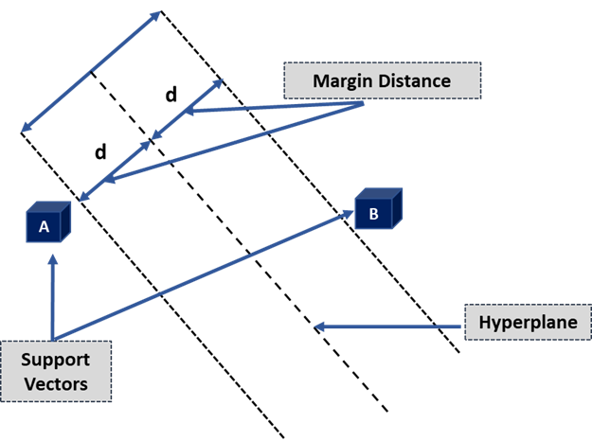
Key terminologies of SVM
1. Hyperplane: or decision boundaries or decision planes: boundaries that aid in the classification of data points.
A hyperplane is a two-dimensional plane when a dataset comprises three features.
2. Support Vectors:
Support vectors are the data points closest to the hyperplane and affect its position.
These vectors are called support vectors because they alter hyperplane location, hence the Support Vector Machine Algorithm.
3. Margin:
The distance between the hyperplane and the support vectors is the margin.
The wider the margin, the more accurate the results are. There are two types of margins in SVM algorithms: hard and soft.
SVM can select two parallel lines that maximize the marginal distance when the training dataset is linearly separable; this is known as a hard margin.
The SVM admits some margin violations when the training dataset is not linearly separable. A soft margin permits some data points to remain on the wrong side of the hyperplane or between the margin and the hyperplane while maintaining accuracy.ypes of SVM
Notes:
https://www.shiksha.com/online-courses/articles/support-vector-machines-python-code/
1. Hyperplane:
Hyperplanes, also known as decision boundaries or decision planes, are the boundaries that aid in the classification of data points. The side of the hyperplane where a new data point lands can be divided into multiple groups. The hyperplane’s dimension is determined by the number of features assigned to a dataset. The hyperplane can be a simple line if the dataset only has two features. A hyperplane is a two-dimensional plane when a dataset comprises three features.
2. Support Vectors:
Support vectors are the data points closest to the hyperplane and affect its position. These vectors are called support vectors because they alter hyperplane location, hence the Support Vector Machine Algorithm.
3. Margin:
The distance between the hyperplane and the support vectors is the margin. The hyperplane that optimizes the margin is always chosen using SVM. The wider the margin, the more accurate the results are. There are two types of margins in SVM algorithms: hard and soft.
SVM can select two parallel lines that maximize the marginal distance when the training dataset is linearly separable; this is known as a hard margin. The SVM admits some margin violations when the training dataset is not linearly separable. A soft margin permits some data points to remain on the wrong side of the hyperplane or between the margin and the hyperplane while maintaining accuracy.

Slide 48
SVM coding video
Watch the video and try to code this in your Python environment
https://www.youtube.com/watch?v=TtKF996oEl8

Slide 49
reference
Gavrilova,Y.2021. Naive Bayes Algorithm for Beginners.[Online].Available at: https://serokell.io/blog/naive-bayes-classifiers
Navlani, A. & Awan, A. A., 2023. Naive Bayes Classification Tutorial using Scikit-learn. [Online].Available at: https://www.datacamp.com/tutorial/naive-bayes-scikit-learn
Simplilearn. 2018.Learn how to build and evaluate a Naive Bayes Classifier using Python's Scikit-learn package .[Online].Available at: https://www.youtube.com/watch?v=l3dZ6ZNFjo0
Digitalmind.2022. Train-test split and cross-validation.[Online].Available at: https://digitalmind.io/post/train-test-split-and-cross-validation
Digitalmind.2022.Saving Machine Learning Models.[Online].Available at: https://digitalmind.io/post/saving-machine-learning-models#saving-machine-learning-models
Singh,Y.2022.How to Generate Datasets Using make_classification .[Online].Available at: https://proclusacademy.com/blog/sklearn_make_classification/
KHALUSOVA,M.2022. MACHINE LEARNING MODEL EVALUATION METRICS PART 2: MULTI-CLASS CLASSIFICATION. .[Online].Available at: https://www.mariakhalusova.com/posts/2019-04-17-ml-model-evaluation-metrics-p2/
Sim,N.2021.Understanding Multi-class Classification Confusion Matrix in Python..[Online].Available at: https://nicoleeesim97.medium.com/understanding-multi-class-classification-confusion-matrix-in-python-8a45848ed28
Rashida.2022.Learn Precision, Recall, and F1 Score of Multiclass Classification in Depth .[Online].Available at:.https://regenerativetoday.com/learn-precision-recall-and-f1-score-of-multiclass-classification-in-depth/
BPRASAD.2022.Confusion Matrix – How to plot and Interpret Confusion Matrix.[Online].Available at: https://lifewithdata.com/2022/02/06/confusion-matrix-how-to-plot-and-interpret-confusion-matrix/

Slide 50
reference
investopedia.com - Bayes' Theorem: What It Is, Formula, and Examples
wikipedia.org - Bayes' theorem
plato.stanford.edu - Bayes' Theorem
corporatefinanceinstitute.com - Bayes' Theorem - Definition, Formula, and Example
mathsisfun.com - Bayes' Theorem
byjus.com - Bayes Theorem - Statement, Proof, Formula, Derivation & ...

Slide 51
reference
Siddarth.2022.A Detailed Overview to the Basics of Support Vector Machines in Machine Learning .[Online].Available at: https://www.pycodemates.com/2022/07/support-vector-machines-detailed-overview.html
Kumar.A. 2023.Support Vector Machine (SVM) Python Example.[Online].Available at:https://vitalflux.com/classification-model-svm-classifier-python-example/
Dwarki,V.2022.Support Vector Machines: Python code.[Online].Available at: https://www.shiksha.com/online-courses/articles/support-vector-machines-python-code/
Unfold Data Science.2022.Support vector machine in machine learning | Support vector machine python | SVM parameter tuning.[Online].Available at: https://www.youtube.com/watch?v=VB_OcBYh3bw
Babar,A,Z.2023.How to implement SVM in Python using Scikit-learn.
https://www.educative.io/answers/how-to-implement-svm-in-python-using-scikit-learn
https://www.kaggle.com/code/arshid/support-vector-machine-on-iris-flower-dataset/notebook
SVM 2Dimension-Hyperplane: Visualization | Kaggle

